Slide 1

Avazu Private Exchange for aNative (Reporting API v2.0 for SDK Publishers）
Reporting API for APX SDK Publishers
Introduction
This API guide is provided by Avazu Private Exchange for SDK publishers, who have specific needs in integrating APX SDK reporting data into their existing tech platforms. Here we will make detailed intros about the API usage itself as well as provide you some examples of how API calls work when interacting with Avazu’s platforms. To get started you shall get some basic understanding about REST (http://en.wikipedia.org/wiki/Representational_state_transfer) as well as be familar with JSON(http://en.wikipedia.org/wiki/Json).

Slide 2
Method: APX SDK Report API
Method Address: http://apx.avazutracking.net/api/v1/sdk/#getsdkreports
Input Parameters:
Parameter | Description | Method | Required
username | Your APX login user name. | GET (URL) / POST (JSON) | YES
password | Your APX login password. | GET (URL) / POST (JSON) | YES
startday | Your requested reporting start date in the following format: YYYY-MM-DD | GET (URL) / POST (JSON) | YES
endday | Your requested reporting end date in the following format: YYYY-MM-DD | GET (URL) / POST (JSON) | YES
groupby | Group by your data with traffic source or country. Option: trafficsource or country Default: trafficsource | GET (URL) / POST (JSON) | YES
trafficsourceid | Specify several traffic sources in your requested reporting e.g. : 27722,27723 Default: all traffic sources | GET (URL) / POST (JSON) | NO
accumulated | Whether to show the data by day. Option: true or false Default: false | GET (URL) / POST (JSON) | YES

Slide 3
Output Parameters :
Parameter | Description | Return Format
trafficsourceid | Traffic source id of the traffic sources you have added. | Key / Value within a JSON Array
trafficsource | Traffic source name of the traffic sources you have added. | Key / Value within a JSON Array
date | Date of the report in the following format: YYYYMMDD | Key / Value within a JSON Array
impressions | Amount of impressions during the designated date. | Key / Value within a JSON Array
revenue | Amount of revenue during the designated date. | Key / Value within a JSON Array
ecpm | Revenue per 1000 impressions during the designated date. | Key / Value within a JSON Array
requests | Amount of requests during the designated date. | Key / Value within a JSON Array
filledrequests | Amount of filled requests during the designated date. | Key / Value within a JSON Array
fillrate | The percentage of ad requests that were filled with an ad. | Key / Value within a JSON Array
country | Country Code | Key / Value within a JSON Array

Slide 4
Response Code:
Code | Message Decription
0 | Successful
1 | Invalid parameter
2 | Time format is wrong or start day is greater than the end day or time span of more than 7 days.
3 | Username or password is wrong.
Example API Responses:
Group by trafficsource if accumulated is true
{
"code" : 0,
"msg" : "success",
"data" : {
"trafficsource" : "avazu test",
"trafficsourceid" : "27722",
"impressions" : "10000",
"revenue" : 100,
"ecpm" : "10.00",
"requests" : "10000",
"filledrequests" : "9900",
"fillrate" : "99.00%"
},
{
"trafficsource" : "avazu test1",
"trafficsourceid" : "27723",
"impressions" : "10000",
"revenue" : 100,
"ecpm" : "10.00",
"requests" : "10000",
"filledrequests" : "9900",
"fillrate" : "99.00%"
}
}

Slide 5
Group by trafficsource if accumulated is false
{
"code" : 0,
"msg" : "success",
"data" : {
"date" : "20170706",
"trafficsource" : "avazu test",
"trafficsourceid" : "27722",
"impressions" : “20000",
"revenue" : 200,
"ecpm" : "10.00",
"requests" : "10000",
"filledrequests" : "9900",
"fillrate" : "99.00%"
},
{
"date" : "20170706",
"trafficsource" : "avazu test1",
"trafficsourceid" : "27723",
"impressions" : "10000",
"revenue" : 100,
"ecpm" : "10.00",
"requests" : "10000",
"filledrequests" : "9900",
"fillrate" : "99.00%"
},
{
"date" : "20170705",
"trafficsource" : "avazu test",
"trafficsourceid" : "27722",
"impressions" : “20000",
"revenue" : 200,
"ecpm" : "10.00",
"requests" : "10000",
"filledrequests" : "9900",
"fillrate" : "99.00%"
},

Slide 6
{
"date" : "20170705",
"trafficsource" : "avazu test1",
"trafficsourceid" : "27723",
"impressions" : "10000",
"revenue" : 100,
"ecpm" : "10.00",
"requests" : "10000",
"filledrequests" : "9900",
"fillrate" : "99.00%"
}
}
Group by country if accumulated is true
1）All traffic sources or specify more than one source
{
"code" : 0,
"msg" : "success",
"data" : {
"country" : “IN",
"impressions" : "10000",
"revenue" : 100,
"ecpm" : "10.00",
"requests" : "10000",
"filledrequests" : "9900",
"fillrate" : "99.00%"
},
{
"country" : "JP",
"impressions" : "10000",
"revenue" : 100,
"ecpm" : "10.00",
"requests" : "10000",
"filledrequests" : "9900",
"fillrate" : "99.00%"
}
}

Slide 7
2）Specify only one traffic source
{
"code" : 0,
"msg" : "success",
"data" : {
"country" : "IN",
"trafficsource" : "avazu test",
"trafficsourceid" : "27722",
"impressions" : "10000",
"revenue" : 100,
"ecpm" : "10.00",
"requests" : "10000",
"filledrequests" : "9900",
"fillrate" : "99.00%"
},{
"country" : "BR",
"trafficsource" : "avazu test",
"trafficsourceid" : "27722",
"impressions" : "10000",
"revenue" : 100,
"ecpm" : "10.00",
"requests" : "10000",
"filledrequests" : "9900",
"fillrate" : "99.00%",
}
}
Group by country if accumulated is false
1）All traffic sources or specify more than one source

Slide 8
{
"code" : 0,
"msg" : "success",
"data" : {
"date" : "20170706",
"country" : "IN",
"impressions" : "10000",
"revenue" : 100,
"ecpm" : "10.00",
"requests" : "10000",
"filledrequests" : "9900",
"fillrate" : "99.00%"
},
{
"date" : "20170706",
"country" : "JP",
"impressions" : "10000",
"revenue" : 100,
"ecpm" : "10.00",
"requests" : "10000",
"filledrequests" : "9900",
"fillrate" : "99.00%"
},
{
"date" : "20170705",
"country" : "IN",
"impressions" : "10000",
"revenue" : 100,
"ecpm" : "10.00",
"requests" : "10000",
"filledrequests" : "9900",
"fillrate" : "99.00%"
},
{
"date" : "20170705",
"country" : "JP",
"impressions" : "10000",
"revenue" : 100,
"ecpm" : "10.00",
"requests" : "10000",
"filledrequests" : "9900",
"fillrate" : "99.00%"
}
}

Slide 9
2）Specify only one traffic source
{
"code" : 0,
"msg" : "success",
"data" : {
"date" : "20170706",
"country" : "IN",
"trafficsource" : "avazu test",
"trafficsourceid" : "27722",
"impressions" : "10000",
"revenue" : 100,
"ecpm" : "10.00",
"requests" : "10000",
"filledrequests" : "9900",
"fillrate" : "99.00%"
},
{
"date" : "20170706",
"country" : "BR",
"trafficsource" : "avazu test",
"trafficsourceid" : "27722",
"impressions" : "10000",
"revenue" : 100,
"ecpm" : "10.00",
"requests" : "10000",
"filledrequests" : "9900",
"fillrate" : "99.00%",
}
}

Slide 10
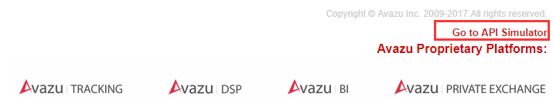
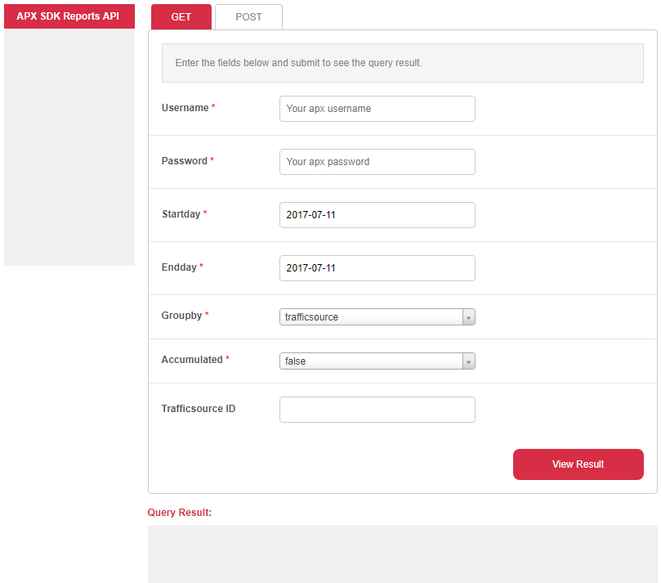
Request Simulator for demonstration purposes:
Under http://apx.avazutracking.net/api/v1/sdk/#getsdkreports you will find a request simulator to speed up your development process and help you troubleshoot possible bugs.

Slide 11
